Slide 1

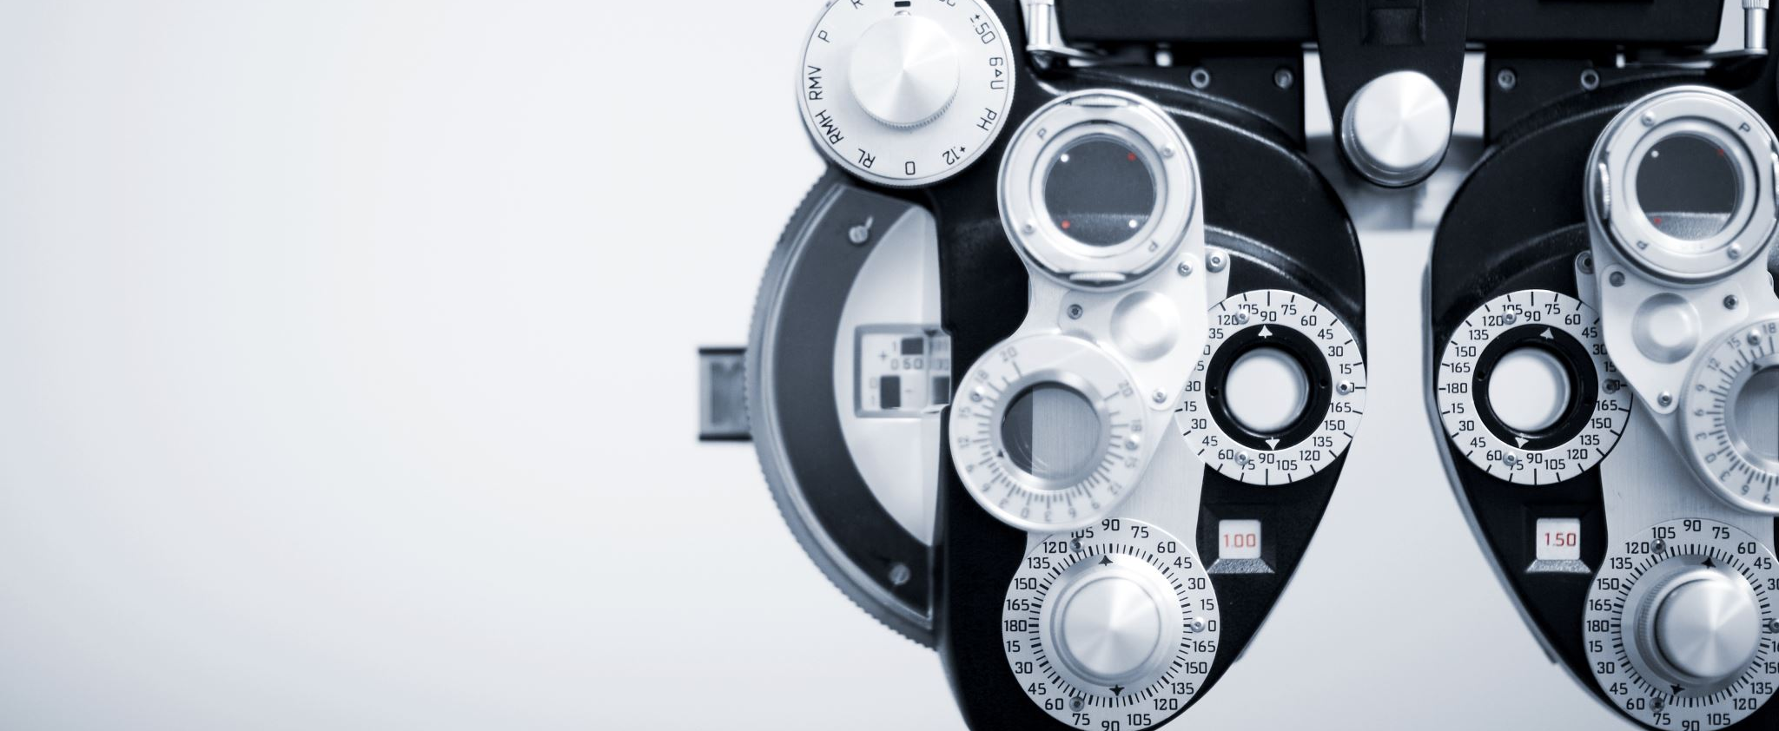
Facial Emotion Detection
By Lemiya Rasheed

Slide 2

Problem Overview
A model that can predict emotions on a human face
We will be looking at 4 emotions
Happy
Neutral
Sad
Surprise
Business Implications of Training a Machine to recognize Facial Emotions
Healthcare, Education, Security & Surveillance, Market Research
Understanding Human behavior, to enable human-computer interaction

Slide 3

Solution Approach
Similar to how humans solve this problem: Spatial Hierarchies
Why CNNs are the best way to solve this problem
Convolutional layers help work with images (parameter sharing, filtering, pooling)
Solution strategy
Understand the input data and apply augmentation
Start with a simple basic CNN
Proceed to adjust the hyperparameters(Trial and Improvement)
RGB vs Grayscale
Additional layers in basic model
Transfer learning techniques-VGG16,ResNet, EfficientNet
Improve model architecture

Slide 4
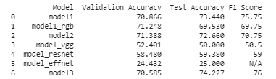
Comparison of model performances

Slide 5

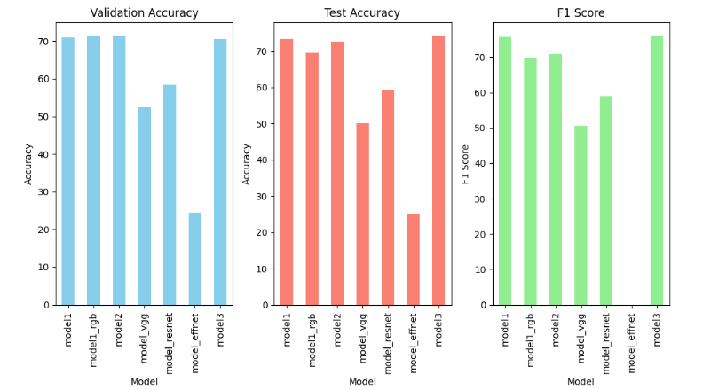


Comparison of model performances

Slide 6
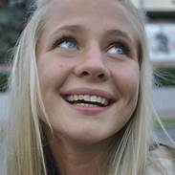
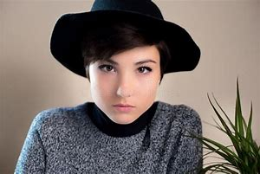

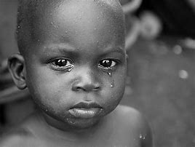
Final architecture
Arch_view1
Arch_view2

Slide 7
Model Parameters and Specifications
Trainable parameters: 5,150,276
Non-trainable parameters: 18496
Training for 20 epochs
Adam optimizer with learning rate of 0.001
Accuracy is chosen as the metric to measure performance

Slide 8
Final Model performance
Training Accuracy – 74%
Validation Accuracy – 71%
Test Accuracy - 77%

Slide 9
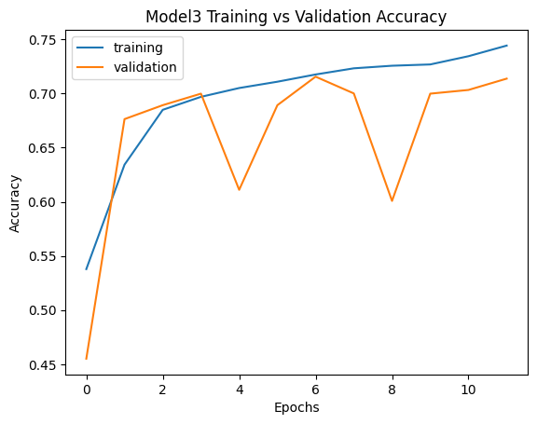
Key Findings & Insights
Model Accuracy vs epoch chart

Slide 10
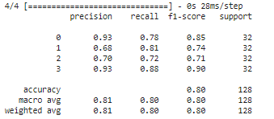
Key Findings & Insights
CLASSIFICATION REPORT

Slide 11
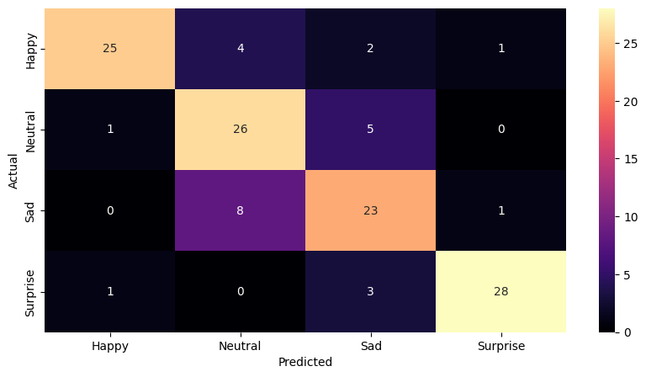
Key Findings & Insights
CONFUSION MATRIX

Slide 12
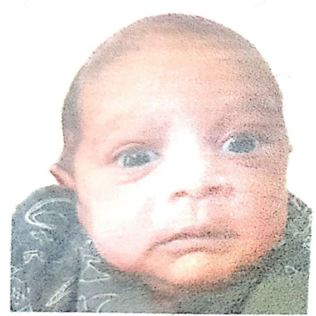
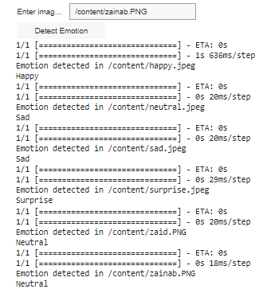
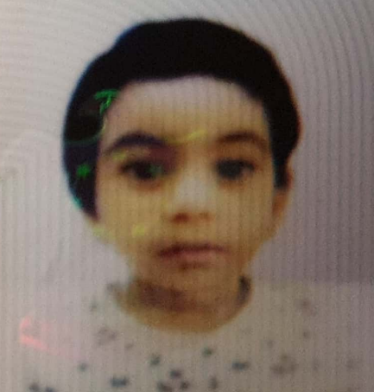
Collab testing on own pics
NEUTRAL
SAD
SURPRISE
SAD
NEUTRAL
HAPPY

Slide 13

Other findings
Grayscale input performs best with models trained for grayscale
The deeper the model, better the performance(Trade off with computation time)
Resnet performs best among the 3 transfer learning models tried
As is for humans, machines find it difficult to differentiate between ‘Sad’ and ‘Neutral’

Slide 14

Risks & Challenges
23% chance of incorrect prediction
Computational costs
Major challenge of computation time while training the model

Slide 15
Recommendations & Next steps
Recommendations
Deployment
Ethical challenges
Training for end users
Feedback
Next steps
Model accuracy improvement with further training including more images of the ‘Sad’ and ‘Neutral’ Classes
Increasing the number of fully connected layers could increase performance
Expanding to other emotions like “Angry” “Disgust”

Slide 16

THANK YOU

